Slide 1
If statements Lists
Week 5 – Day 2
CS-1064 Intro to Python
Dr. Panagiotis Apostolellis, Virginia Tech, 2018

Slide 2
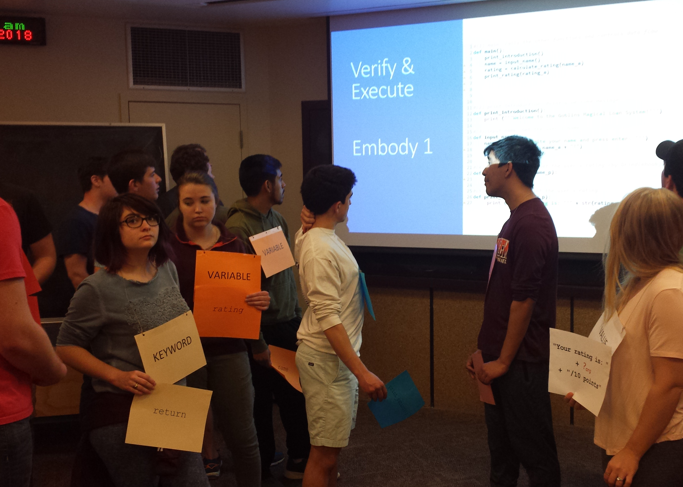
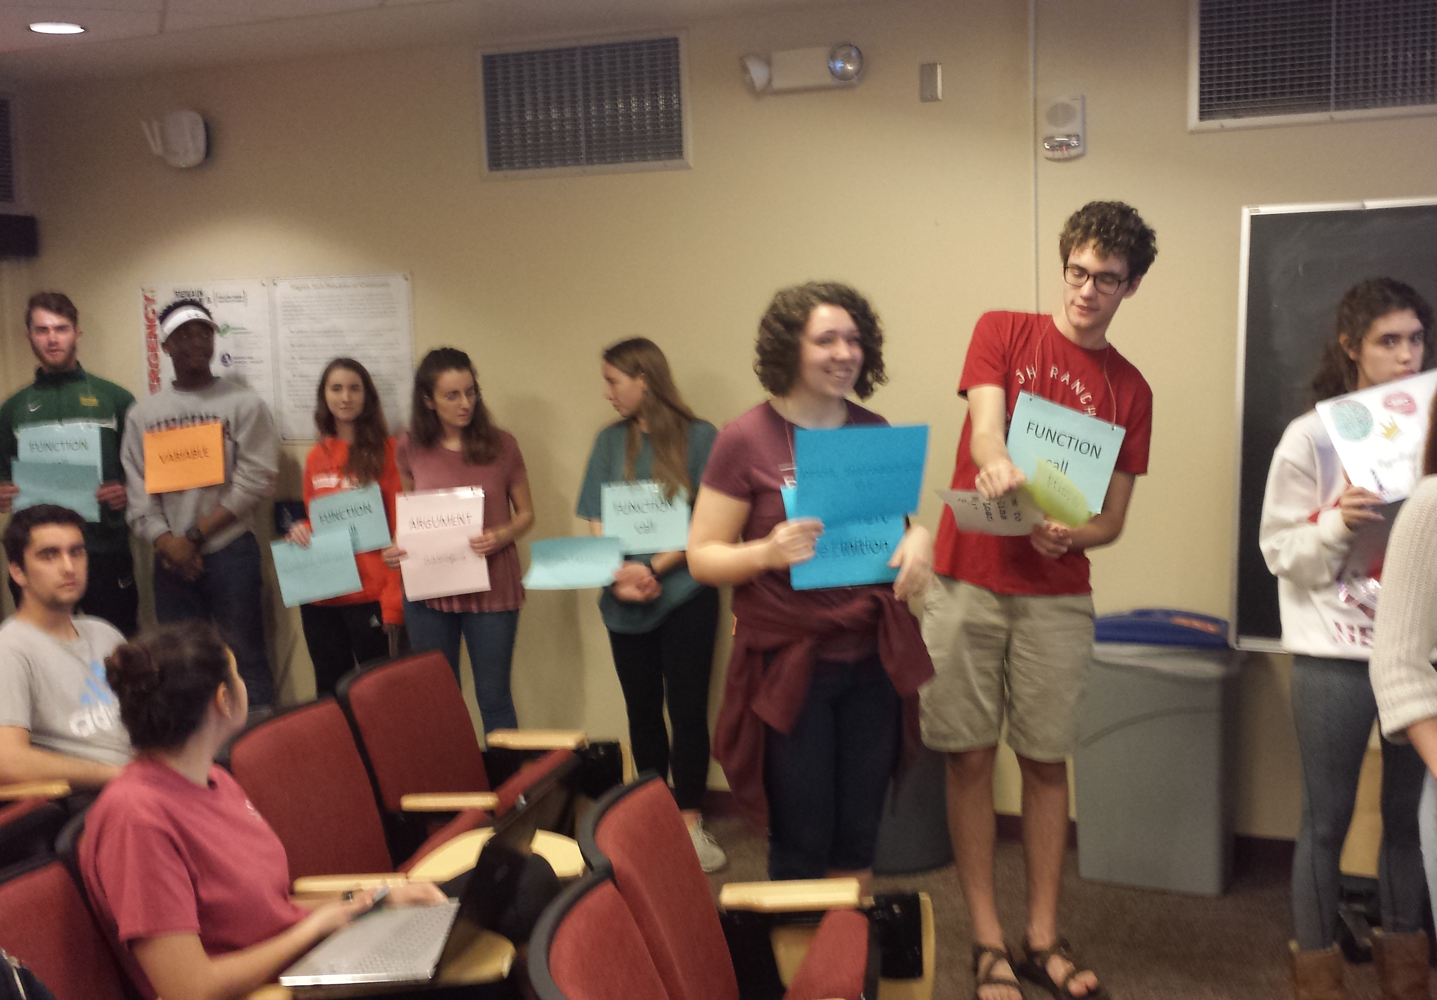
Activity Feedback
What was the one thing that you feel had the greatest impact on you?
Notes:
Set the stage for the project. The context is that they are a programmer for a goblin bank, making a system for approving wizard loans. Their senior colleague has given them an awful function they must use. They have to write the rest of the system.
After giving an overview, open up the example solution and show what it looks like when you run (avoid sharing the code itself).

Slide 3
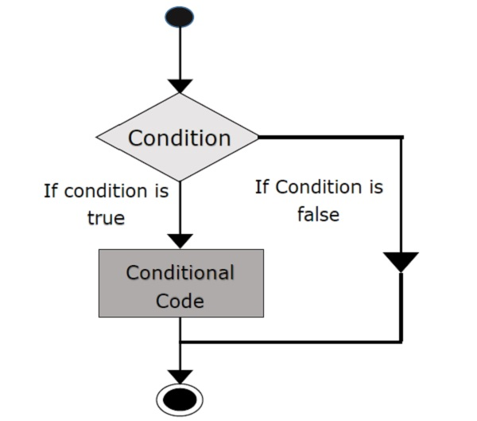
If-then Statements
Branching flow and conditions
Notes:
Highlight the main idea of an IF statement. We can use them to ask questions and make the system do different things based on different situations.

Slide 4
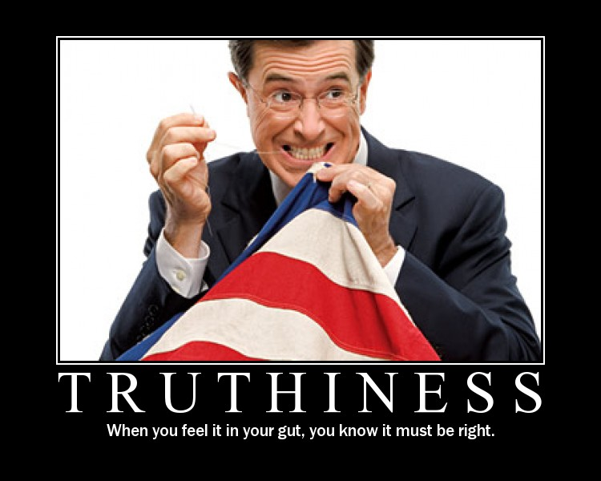
Truthiness
All values can be used as conditionals regardless of their type
None, 0, “” -> False
Any number/string -> True
Notes:
A fun idea in Python is that all values can be used as conditionals. False values are empty strings, 0, None, and of course False.
Basically, if you're testing that it's not empty or not 0 or not None, then you don't need those extra evaluations.

Slide 5

Which is the best practice to check this statement?
has_dog = True
B)
A)
if has_dog:
print(True)
else:
print(False)
if has_dog == True:
print(True)
else:
print(False)
C)
D)
print(has_dog)
print(has_dog == True)
Notes:
"Best" is an arbitrary idea. In this case, however, it's not hard to make the case that C is the best choice. Using an if statement is unnecessary and adds indentation and code complexity. Testing against True is unnecessary and slower.

Slide 6
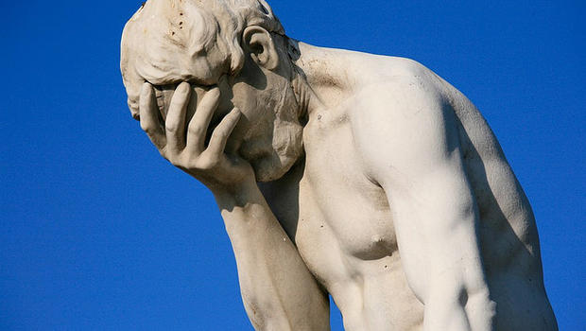
Common Mistakes
If boolean == True
if boolean,
return True
else
return False
If boolean
return boolean
Notes:
This nails the two mistakes exactly. People think they need to explicitly test if a Boolean is equal to true. But that's redundant, because if it is true then the result is true, and if it is false then the result is false. Having a good variable name really helps here: that way you can just say "if has_dog".
The other common mistake is when you don't treat Boolean values as values. If you just need to return a Boolean value, then you don't need to use an if statement. If statements are good when you need to have different behavior for a conditional, but if you just want to return the same value, there's no need to make it 4x as long!

Slide 7
How many possible paths to the end?
if has_dog:
if number_of_dogs > 5:
print("A lot of dogs!")
else:
print("A few dogs")
else:
print("No dogs")
0
1
2
3
4
Notes:
This slide is animated. First, ask the question (hopefully most come up with 3). Then the animation plays out which shows the different paths. Each IF statement introduces two new branches, but this isn't simple addition. Inner IF statements fork a branch. Don't forget to mention that the ELSE is optional, but the IF statement still introduces two paths.
Reading the flow of conditional code is tricky. It might be a good idea to trace some code with this slide too, copying the code and setting different values.

Slide 8
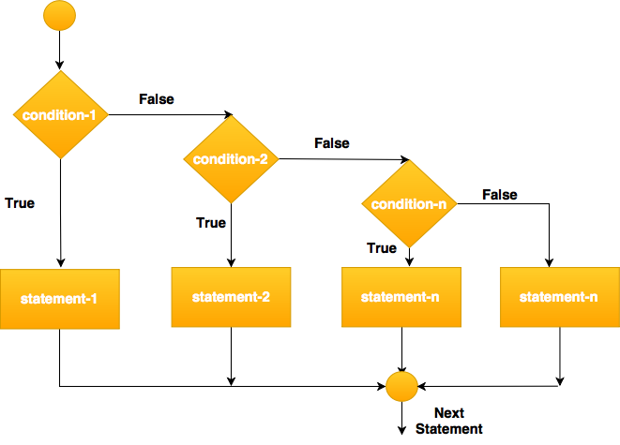
If-then-else statements
else
else
else
Nesting if-then-else statements for multiple conditional checks

Slide 9
How many keywords?
if
for
input
print
def
len
2
3
4
5
6
Notes:
At this point, we've seen a lot of terminology, so now's a good time to reinforce Functions vs. Keywords. The answer is B (3) as shown on the next slide.

Slide 10

What is a list?
An ordered representation of some data
Notes:
Lists are a powerful tool for collecting related data into the same place. Any noun can be collected – you have a list of students, a list of grades, a list of commands, a list of whatever. Lists are just an ordered representation of some data.

Slide 11
Which of these func definitions has a list parameter?
def find_biggest( ? ):
a_list
[a_list]
"a_list“
[] a_list
Notes:
Around this time, students start getting anxious about types. They'll try and force parameters to have types, especially if they come from a Java/C background. But parameters don’t have types, and they'll make mistakes like B and C. For the record, A is the correct choice.

Slide 12
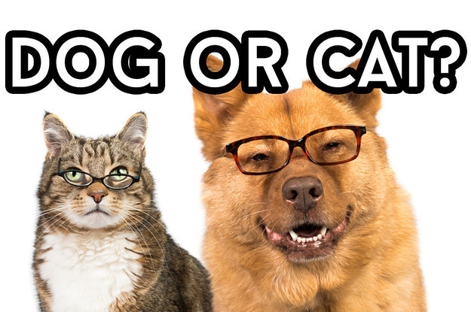
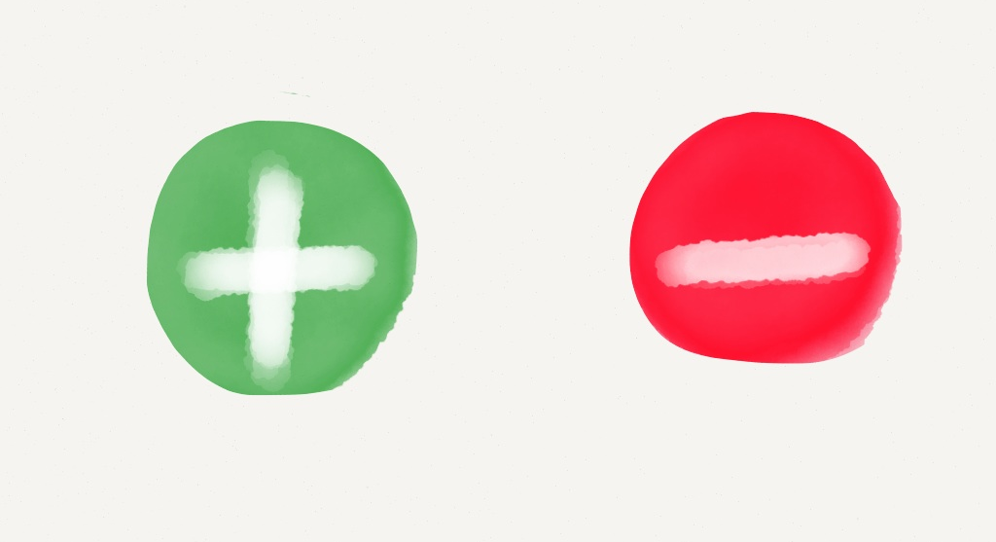
Using Lists
Create a function check_animals that will consume a list of strings and returns whether any of them are "cat" or "dog".
Create a function make_extents that consumes a number and returns a list with that number and its negation.
Notes:
You'll want to do some worked examples of working with lists. Here are two example problems.
def check_animals(animals):
return "cat" in animals or "dog" in animals
def make_extents(a_number):
return [-a_number, a_number]

Slide 13

Reminders
Project 2 closes on Friday 2/23 at 11:59 pm
Module 4 closes on Friday 2/23 at 11:59 pm

Slide 14

Lab Time
Work on class assignments
Finish as many problems as possible
Use instructor and TA’s time for assistance
IF YOU PLAN TO LEAVE
Make sure you inform me or the TAs
Show us your work progress
Notes:
You can wrap up the discussion on operators by going over these many examples of (potentially) confusing rules for the operators. The thing to highlight is that each operator has its own rules, and they should experiment when trying to mix types. Usually it doesn't work, sometimes it does.

